Slide 1
INT222
DOM & Events

Slide 2
Announcements
Lab - (Due this time next week!)
Quiz 6 Next Week! (Covers this lecture)
(Review during the lab)

Slide 3
Agenda
Document Object Model (DOM)
DOM Tree, Node
DOM Events

Slide 4
The Document Object Model (DOM)
The Document Object Model (DOM) is an 2-way application programming interface (API) for HTML (and XML) documents.
Essentially, you can think of it as a way to access / manipulate the complex "document" object that is created on the client side when a browser loads an HTML page (document).
It defines how the document structure, style and content can be accessed and manipulated.
It provides a structured representation of the document.
With the DOM, programmers can build documents, navigate their structure, and add, modify, or delete elements and content using JavaScript or other languages.

Slide 5
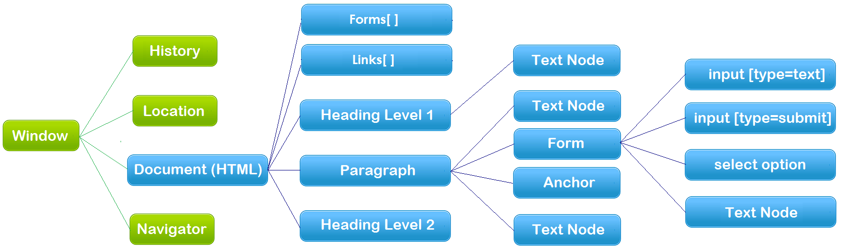
The Document Object Model (DOM)
An example of the hierarchy of the Document Object Model (blue)
Document – HTML Document/file
API – each node above is an object that has properties and methods

Slide 6
document Object
An HTML document loaded into a browser window becomes a document object.
The document object provides access to all HTML elements in a page, from within a script.
The document object is also part of the Window object, and can be accessed through the window.document property.

Slide 7
document Object
document object properties and methods (legacy DOM):
document.anchors | Returns a collection of all the anchors in the document
document.body | Returns the body element of the document
document.domain | Returns the domain name of the server that loaded the document
document.forms | Returns a collection of all the forms in the document
document.images | Returns a collection of all the images in the document
document.links | Returns a collection of all the links in the document
document.referrer | Returns the URL of the document that loaded the current document
document.title | Sets or returns the title of the document
document.url | Returns the full URL of the document
document.write() | Writes HTML expressions or JavaScript code to a document
document.writeln() | write() with a newline character after each statement

Slide 8
Examples
A form input element could be accessed using:
document.formName.inputElementName
document.forms[0].elements[0]
More…
Two-way API example:
Get/Read:
Set/Write:
Example: document.html
var ttl = document.title;
alert(ttl);
document.title = "new title";

Slide 9
document Object
Document object methods – get/query element(s):
document.getElementsByName()
document.getElementsByClassName()
document.getElementsByTagName()
document.querySelector()
Returns the first element that matches a specified CSS selector(s) in the document
document.querySelectorAll()
Returns a static NodeList (array) containing all elements that matches a specified CSS selector(s) in the document
Examples:
var paras = document.getElementsByTagName("p");
var example = document.querySelector("p.example");

Slide 10
document Object
document object properties and methods:
document.createElement()
document.createTextNode()
document.createAttribute()
document.createComment()
document.addEventListener()
Example: create-element.html

Slide 11
The DOM Tree
When a HTML document is loaded, the browser creates a Document Object Model.
The DOM represents a document as a tree.
<!doctype html>
<html>
<head>
<meta charset="UTF-8" />
<title>This is a Document!</title>
</head>
<body>
<h3>Welcome!</h3>
<p>This is a paragraph.</p>
<p>This is a paragraph with a <a href="index.html">link</a> in it.</p>
<ul>
<li>first item</li>
<li>second item</li>
<li>third item</li>
</ul>
</body>
</html>

Slide 12
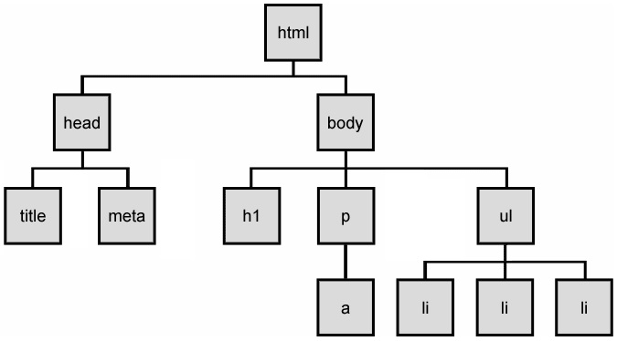
The DOM Tree
The HTML elements of the page are nested into a tree-like structure of objects.
The tree is made up of parent-child relationships, a parent can have one or many children elements.
Example: dom-tree.html

Slide 13
HTML DOM Nodes
A document is a structure of nodes.
Everything in an HTML DOM is a node.
window.document, each element,
attributes and text inside elements are nodes,
DOCTYPE, comments, whitespaces are also nodes.
All these DOM objects inherit from a node object, which provides properties and methods (ie: Web API Interfaces)
DOM document object
DOM Element objects
DOM Attribute objects
DOM Event object

Slide 14
Document Object Model (DOM)
HTML documents are made up by HTML elements
In the HTML DOM, every HTML element is represented by an element object (node).
Types of DOM nodes
element nodes (HTML tag)
For each HTML element, there is a node object. It can have children and/or attributes
text nodes (text in an element)
attribute nodes (attribute/value pair)
text/attributes are children in an element node
cannot have children or attributes
not usually shown when drawing the DOM tree

Slide 15
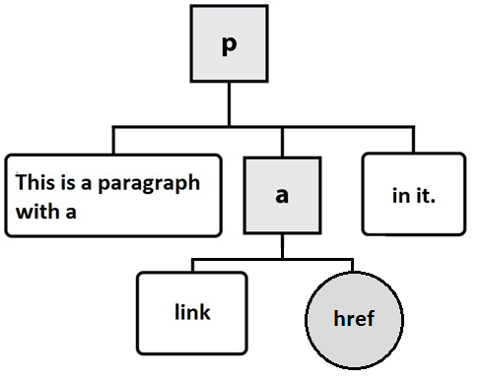
At the Ends of DOM Tree
HTML
DOM nodes
element nodes
text nodes
attribute nodes (not typically drawn)
<p>This is a paragraph with a <a href="index.html">link</a> in it.</p>

Slide 16
Element Nodes/Objects
Properties and Methods of element nodes/objects – the standard API
Properties:
Methods:
Reference: The HTML DOM Element Object
element.className
element.id
element.style
element.innerHTML
element.parentNode
element.nextSibling
…
element.getElementsByTagName()
element.getElementsByClassName()
element.querySelector()
element.querySelectorAll()
element.addEventListener()
element.appendChild()
element.insertBefore()
element.removeChild()
element.setAttribute()
element.getAttribute()

Slide 17
Example
Highlight all paragraphs within a div element:
HTML:
Example: node-elements.html
JavaScript:
<p>Mail to: </p>
<div id="address">
<p>70 The Pond Road</p>
<p>Toronto, ON</p>
</div>
var elem = document.querySelector("#address").;
var addrParas = elem.getElementsByTagName("p");
// highlight all paragraphs inside the div element
for (var i = 0; i < addrParas.length; i++) {
addrParas[i].style.backgroundColor = "yellow";
}

Slide 18
Methods for selecting elements
Selecting groups of elements within an element object, including document object
name | description
getElementsByTagName() | Returns a collection of all child elements with the specified tag name
getElementsByClassName() | Returns a collection of all child elements with the specified class name
querySelector() | Returns the first element that matches the selector specified in the parameter
querySelectorAll() | Returns a static (non-live) NodeList (array) of all elements that match the selector specified in the parameter. NOTE: by "non-live" we mean that the array will not reflect changes to the element list based on the addition / subtraction of new nodes. It's more of a "snapshot" of elements.

Slide 19
Modifying DOM with JavaScript
Modifying HTML Structure and content with JavaScript

Slide 20
Creating New Nodes
NOTE: This merely creates a node; it does not add it to the page
You must add the new node as a child of an existing element on the page, ie:
name | description
document.createElement("tag") | creates and returns a new empty DOM node representing an element of that type
document.createTextNode("text") | creates and returns a text node containing given text
// create a new <h2> node
var newHeading = document.createElement("h2");
var t = document.createTextNode(" This is a heading ");
newHeading.appendChild(t);
newHeading.style.color = "blue";
document.body.appendChild(newHeading);

Slide 21
Modifying the DOM tree
Every DOM element object has these methods:
Examples:
node_appendChild.html
node_insertBefore.html
node_removeChild.html
node_replaceChild.html
name | description
appendChild(node) | places given node at end of this node's child list
insertBefore(new, old) | places the given new node in this node's child list just before old child
removeChild(node) | removes given node from this node's child list
replaceChild(new, old) | replaces given child with new node

Slide 22
Modifying element / node attributes
name | description
hasAttribute(name) | checks if the attribute exists
getAttribute(name) | gets an attribute value
setAttribute(name, value) | sets an attribute
removeAttribute(name) | removes an attribute

Slide 23
Modifying element / node attributes
Example 1:
Example 2 (Modifying element / node attributes)
Example 3:
var i, elems = document.getElementsByName("pets");
for (i = 0; i < elems.length; i += 1) {
// elems[i].type = "checkbox";
elems[i].setAttribute('type', 'checkbox');
}
var elem = document.querySelector("#d1");
elem.setAttribute("class", "notes");
// or simply: elem.class = "notes";
document.querySelector("#image").height = "200";
document.querySelector("#image").src="pic2.jpg";

Slide 24
innerHTML Property
Example – 2-way API: innerHTML2.html
Note: innerHTML property can be used to add elements / objects into a web page. e.g.
However: Creating elements like this breaks our separation of concerns and is error prone. Use innerHTML for simple text and tags only!
document.querySelector("#xy12").innerHTML += "<p style='color: red; " +
"margin-left: 50px;' " +
"onclick='myOnClick();'>" +
"A paragraph!</p>";

Slide 25
Modifying DOM with JavaScript
Modify HTML formatting and appearance

Slide 26
Adding / Removing Classes
In order to keep our separation of concerns intact (ie: JavaScript, CSS & HTML as separate as possible), the best practice for modifying the style of an element using JavaScript is by adding or removing classes
This can be done using the element.classList methods:
add( String [, String] )
Add specified class values. If these classes already exist in attribute of the element, then they are ignored.
remove( String [,String] )
Remove specified class values.
Example: js-classlist.html

Slide 27
HTML DOM Events
Responding to user input

Slide 28
Events
In general everything that happens in a browser may be called an event.
e.g. an event occurs when a user clicks on a link or a button in a form
Every element on a web page has certain events which can trigger a JavaScript function.
JavaScript needs a way of detecting user actions so that it knows when to react.
It also needs to know which functions to execute.

Slide 29
Common Events
Events triggered by user actions.
e.g.
When a user clicks the mouse
When a user presses a key
When the mouse moves over an element
When an input field is changed
When an HTML form is submitted
Events that are not directly caused by the user.
e.g.
When a web page has finished loading
When an image has been loaded
Full List Includes:
Mouse events, keyboard events, HTML frame/object events, HTML form events, user interface events, touch events, etc…

Slide 30
Event Handlers
Event Handlers are used to manipulate documents.
An event handler is used in order to execute a script when an event occurs.
The event handler has a prefix "on" followed by the event name.
For example, the event handler for the click event is onclick.
<button onclick="myFunction()">Click me</button>

Slide 31
Creating Event Handlers
General syntax:
<htmltag id="someId" eventHandler="JavaScript Code">
e.g.
Note:
The event handlers in HTML must be enclosed in quotation marks.
Alternate double quotation marks with single quotation marks to pass strings to your functions:
eg.
<input type="button" value="New Button!" onclick="alert('some text');" />
<input type="button" value="New Button!" onclick='alert("some text")' />

Slide 32
Creating Event Handlers – Using DOM
The HTML DOM allows you to create an event object for a specific element using JavaScript
This is a better solution, as it helps to separate structure & behaviour (no "on" events in our structure (HTML))
Example: js-event-init.html
<script>
function displayDate() {
document.querySelector("#demo").innerHTML = (new Date()).toLocaleString();
}
window.onload = function() { // why use window.onload?
var elem = document.querySelector("#myBtn");
elem.onclick = displayDate;
// elem.addEventListener( "click", displayDate ); // also works
};
</script>

Slide 33
Event Handler Examples - onchange
onchange:
occurs when the content of a field changes.
Applies to :
<select>, <textarea>, <input> elements
Example: js_onchange.html

Slide 34
Event Handler Examples - onclick
onclick:
Occurs when the user has pressed and released a mouse button (or keyboard equivalent) on an element.
Applies to:
Any HTML element
Example: js_onclick.html

Slide 35
Event Handler Examples - ondblclick
ondblclick:
Occurs when the user has double-clicked a mouse button on an element.
Applies to:
Any HTML element
Example: js-ondblclick.html

Slide 36
Event Handler Examples - onfocus
onfocus:
Occurs when the user has given focus to an element.
Applies to:
Any HTML element, but typically: <input>, <select>, <a>, <button>, <textarea>
Example: js-onfocus.html

Slide 37
Event Handler Examples - onload
onload:
Occurs when a document or other external element has completed downloading all data into the browser.
Applies to:
<body>, <img>, <input>, <link>, <script>, <style>
Example: js-onload.html

Slide 38
Event Handler Examples - onmouseout
onmouseout:
Occurs when the user has rolled the mouse out of an element.
Applies to:
Any HTML element
Example: js-onmouseout.html

Slide 39
Event Handler Examples - onmouseover
onmouseover:
Occurs when the user has rolled the mouse on top of an element.
Applies to:
Any HTML element
Example: js-onmouseover.html

Slide 40
Event Handler Examples - onresize
onresize:
Occurs when the user has resized a window or object.
Applies to:
<body> (window)
Example: js-onresize.html

Slide 41
Event Handler Examples - onbeforeunload
onbeforeunload :
The onbeforeunload event fires when the document is about to be unloaded.
Applies to:
(window)
Example: js-onbeforeunload.html

Slide 42
Timer Events
method | description
setTimeout(function, delayMS); | arranges to call given function after given delay in ms
setInterval(function, delayMS); | arranges to call function repeatedly every delayMS ms
clearTimeout(timerID); clearInterval(timerID); | stops the given timer so it will not call its function
The first 2 methods return timerID which can be used to stop the timer by using the last 2 methods.
E.g:
<button onclick="setInterval(function(){alert('Hello')},3000);"> Try it</button>

Slide 43
Helpful Resource Links
MDN: Introduction to DOM
MDN: DOM Examples
MDN: Creating New Elements
JavaScript Kit: DOM Reference
W3C: Handling events with JavaScript

Slide 44
Questions?
Any questions?
Would you like to see any more examples?

